Slide 1

SRM INSTITUTE OF SCIENCE AND TECHNOLOGY, RAMAPURAM CAMPUS
DEPARTMENT OF COMPUTER SCIENCE AND ENGINEERING
DOMAIN: MACHINE LEARNING
PROJECT TITLE: FACE DETECTION IN SECURITY MONITORING REPORT
Batch No: 22
DETAILS OF THE PROJECT MEMBERS
KARTHIK.S - RA1911027020059
DARSAN.R.A - RA1911027020045
DIVYESH KUMAR - RA1911027020052
Under The Guidance Of
MS.A. VIDHYAVANI
(Assistant Professor, Department of Computer Science and Engineering)
BACHELOR OF TECHNOLOGY
in
COMPUTER SCIENCE AND ENGINEERING
of
FACULTY OF ENGINEERING AND TECHNOLOGY

Slide 2
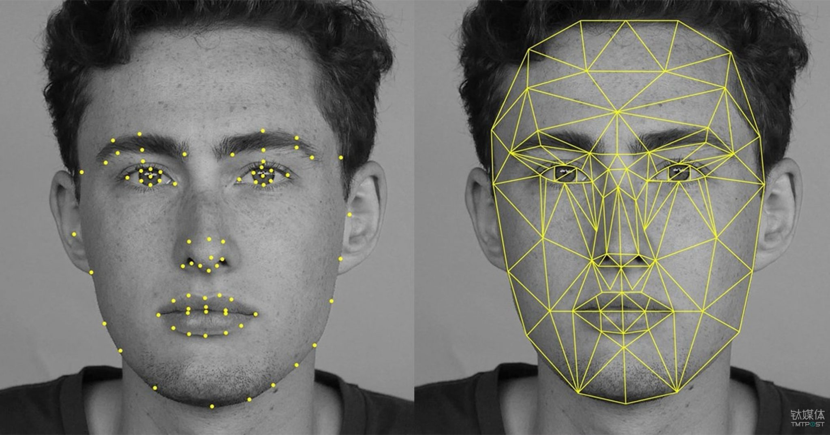
FACE DETECTION

Slide 3


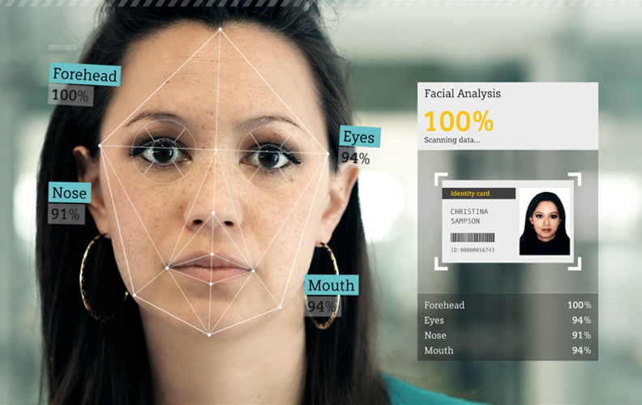
ABSTRACT
Video Monitoring
Intelligent Video retrieval Technology
Computer Vision
Deep Learning

Slide 4
S.NO | JOURNAL NAME | YEAR OF PUBLICATION | PAPER TITLE | AUTHORS | DESCRIPTION
1 | IEEE EXPLORE | 24th Sep,2020 | Face Detection Based On Receptive Field Enhanced Multi-Task Cascaded CNN | Xiaochao Li, Zhenjie Yang and hong wei | proposed a Receptive Field Enhanced Multi-Task Cascaded CNN
2 | IEEE EXPLORE | 25th Nov, 2019 | Small Faces Attention Face Detector | Shi Luo, Xiongfei Li and Rui Zhu | proposed a novel scale-invariant face detector, named Small Faces Attention face detector, for better detecting small faces.
3 | IEEE EXPLORE | 27th Aug , 2019 | Real-Time Surveillance Through Face Recognition Using Hog And Feed Forward Networks | Muhammad Awais, and mohammad basheri | This paper provides video surveillance with improved accuracy and less computational complexity.
4 | IEEE EXPLORE | 12th Aug, 2019 | Face Detection Method Based On Cascaded CNN | Rong Qi, and Ling-Qun Zuo | Proposed framework which leverages a cascaded architecture with three stages of deep convolutional networks to improve detection performance.
5 | IEEE EXPLORE | 10th Sep, 2018 | Simultaneous Face Detection And Pose Estimation Using CNN | Hao Wu and Guohui Tian | propose a multi-task CNN cascade framework that integrates these two tasks.

Slide 5
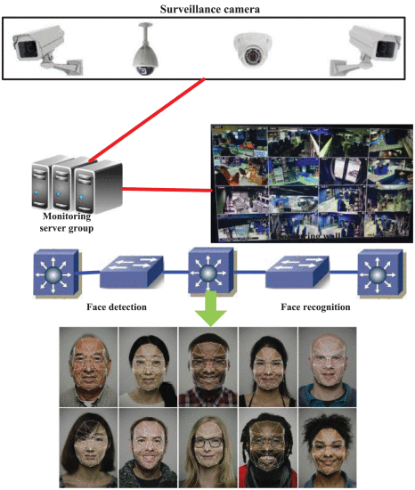
Proposed Model
Video Oriented Cascaded Intelligent Face Detection Algorithm
Deep Learning
CNN Model
Feature Extraction

Slide 6
MODULES

Slide 7
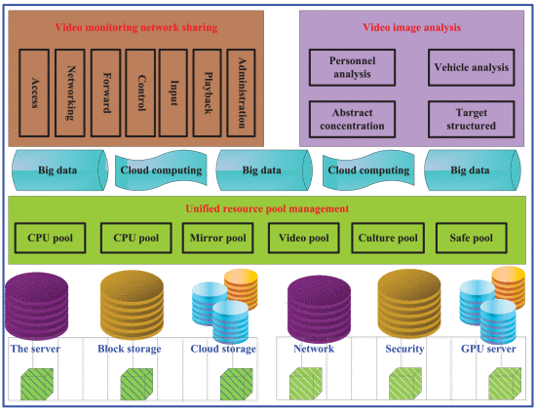
Security Video Monitoring And Retrieval Technology
Massive
Unstructured
Low value density.

Slide 8
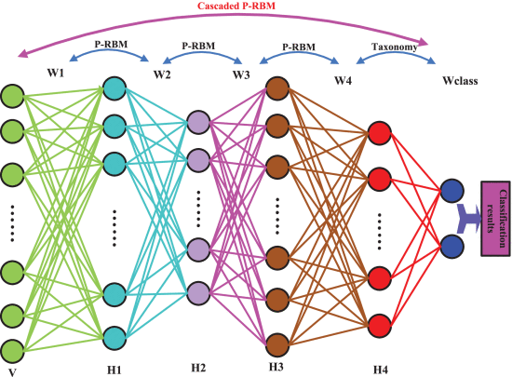
Cascaded P-RBM deep learning detection network

Slide 9
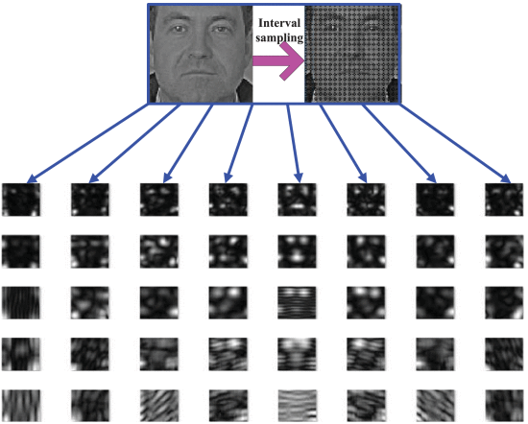
Deep Learning Face Detection Based On Video
Edge Feature
Cascaded P-RBM
Visual Layer
Four Hidden Layers

Slide 10
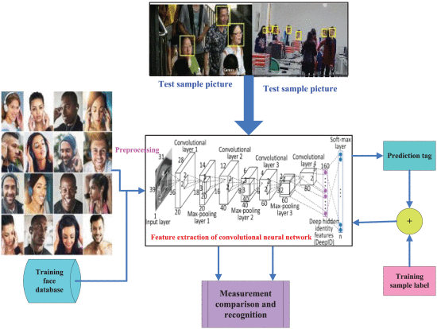
Face Recognition Based On Intelligent
Video Retrieval Technology
Biometric Technology
Feature Extraction Part
Classification Layer
Face Processing
Face Corrrection

Slide 11
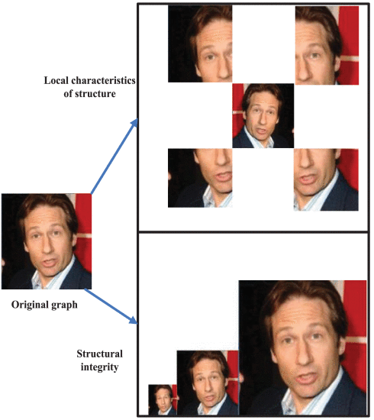
Face Recognition Based on global and local Features
Five key parts
Two network models
Global and Local Features of human face
Associated Recognition

Slide 12
Conclusion
Mainly focuses on the pre-warning analysis of the collected video images
Proposed a cascaded deep learning detection network for video single frame face detection
Biometric recognition
Intelligent video surveillance system

Slide 13
REFERENCES
1. BY Xiaochao Li, Zhenjie Yang, And Hong Wei Wu.
https://ieeexplore.ieee.org/document/9195457
2. BY Shi Luo, Xiongfei Li, Rui Zhu, And Xiaoli Zhang.
https://ieeexplore.ieee.org/document/8911451
3. BY Muhammad Awais, Muhammad Javed Iqbal, Iftikhar Ahmad, Madini O. Lassafi, And Mohammad Basheri.
https://ieeexplore.ieee.org/document/8815725
4. BY Rong QI, Rui-Sheng Jia,QI-Chao Mao, Hong-Mei Sun, Ling-Qun Zuo.
https://ieeexplore.ieee.org/document/8794507
5. BY Hao Wu, KE Zhang, And Guohui Tian.
https://ieeexplore.ieee.org/document/8458127

